Slide 2

Sriram Ganesan
Architect- Cloud Transformation & Engineering at Virtusa
GitHub: @ArchNomad87
LinkedIn: @Sriram Ganesan
Blog: ramsaztechbytes.in

Slide 3
AN APP MODERNIZATION JOURNEY WITH CONTAINERS IN THE LAST MILE

Slide 4
Agenda
Stage setting
6- 7Rs in a Cloud adoption journey
What an Application modernization approach is
Parallel Evolution of Apps and Platform
Reference to an E-Commerce App
Cloud native app deployment
Modernization approach
Target state (containers in the last mile)

Slide 5
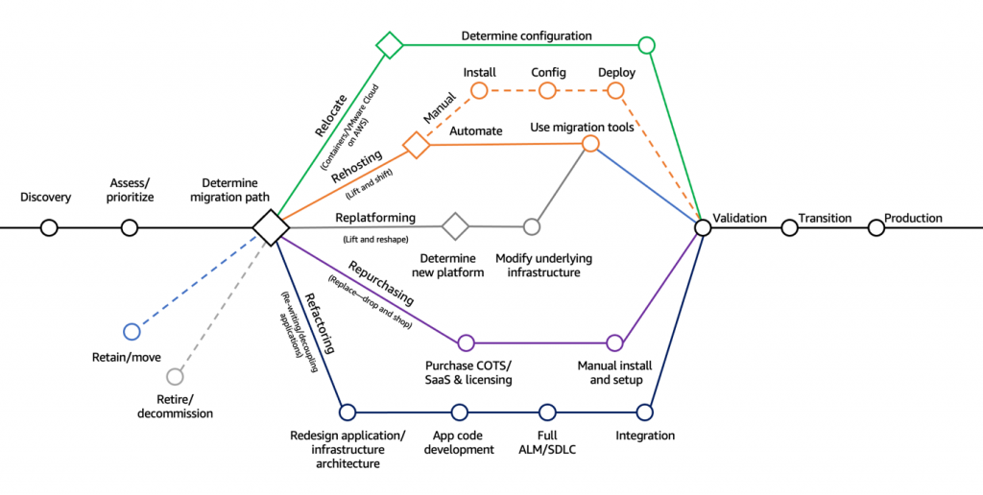
6-7Rs of Cloud Adoption
https://www.evoquedcs.com/blog/revisiting-the-7-r-s-of-cloud-migration-for-digital-transformation

Slide 6
What is App Modernization (or) Innovation
The process of modernizing the features, internal architecture, and/or platform infrastructure of existing legacy applications
Organizations create new business value from aging applications by updating them with modern, well-aligned capabilities and features
Many application modernization approaches are focused on bringing monolithic, on-premises applications into cloud-native architecture and release patterns—specifically, modern application development processes such as microservices & DevOps
Ref: https://avinetworks.com/glossary/application-modernization/

Slide 7
Evolution of apps in relation to the platform
Evolution of the apps can be made less dependent on the evolution of the cloud platform services, as far managed services like AKS are concerned
Product teams can focus on developing their services and apps not worrying about the hosting solution
App/service teams can focus on the programming model and the e2e business logic that would tie the distributed pieces of the application
Choice of Integration services should be made to not depend on the hosting decision of the services (IAAS or PAAS)

Slide 8
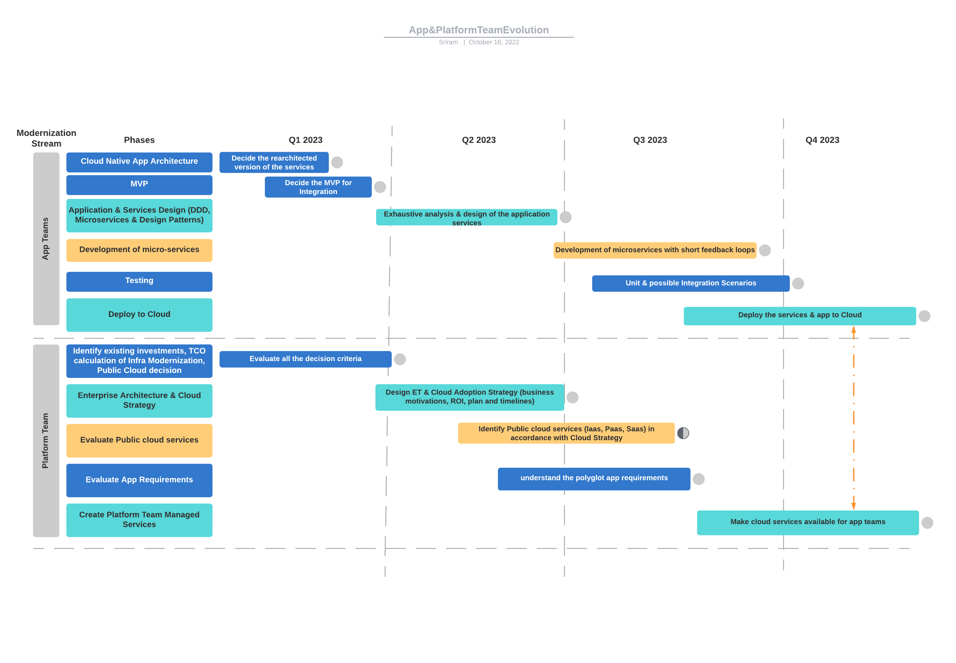
A Hypothetical Case- Comparison of Maturity Timelines

Slide 9
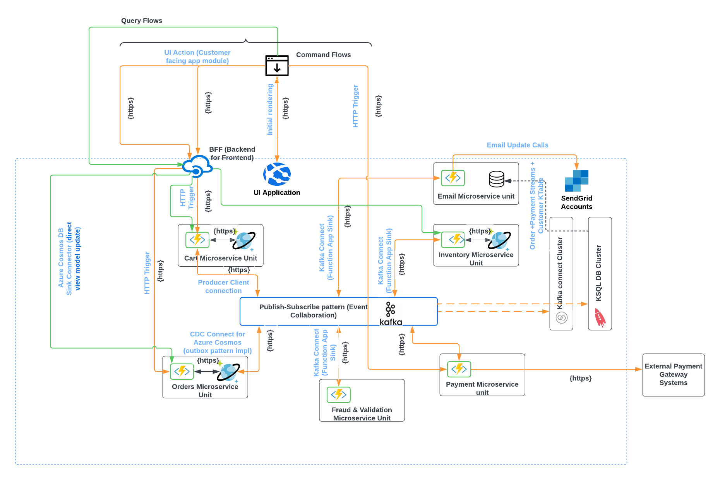
Reference : E-Commerce App Architecture (HL Integration Architecture)

Slide 10
App design & development
E2E event-driven architecture based on SAGA and other microservice design patterns
Functions as the programming approach (Functions has been the best fit for event driven applications)
Integration mechanisms such as Kafka or event hubs are independent of the hosting of the services
Design, implement and run the services in the local box

Slide 11
Cloud native app deployment choices
Serverless Faas using Azure Functions
Containers hosted in
Container Apps
Azure Kubernetes Service (AKS)
Azure Functions
Container Instances

Slide 12
Azure Functions on Kubernetes with KEDA
Anatomy of Azure Functions
A runtime and a scale controller
The Functions runtime runs and executes your code. The runtime includes logic on how to trigger, log, and manage function executions. The Azure Functions runtime can run anywhere
The scale controller monitors the rate of events that are targeting your function, and proactively scales the number of instances running your app
Kubernetes-based Functions
Using Functions containers with KEDA makes it possible to replicate serverless function capabilities in any Kubernetes cluster.
Kubernetes-based Functions provides the Functions runtime in a Docker container with event-driven scaling through KEDA.
KEDA can scale in to 0 instances (when no events are occurring) and out to n instances. It does this by exposing custom metrics for the Kubernetes auto-scaler (Horizontal Pod Autoscaler).
https://learn.microsoft.com/en-us/azure/azure-functions/functions-kubernetes-keda#deploying-a-function-app-to-kubernetes

Slide 13
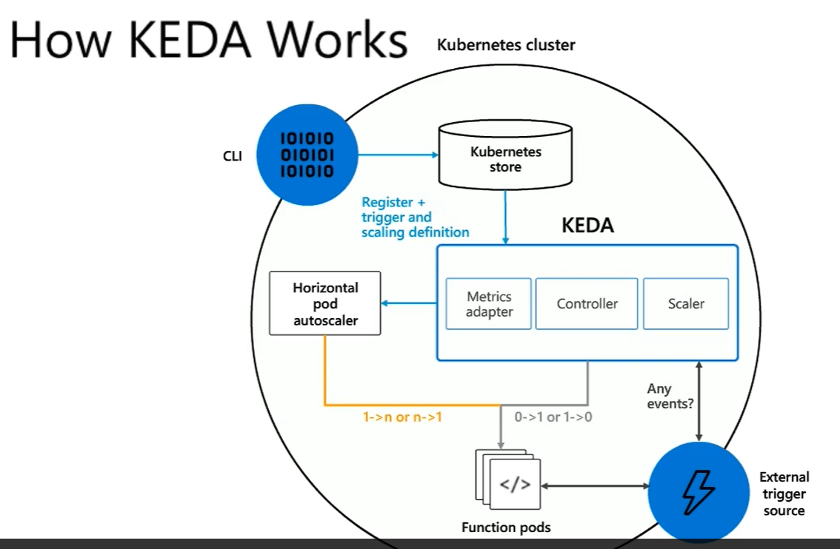
KEDA with Function Pods & Custom Scalers

Slide 14
Azure Functions on Kubernetes with KEDA
Deploy the Cart Service project as a function app in the AKS cluster
Microservices-EDA-Kafka\src> func kubernetes deploy --name
func-cartservice --namespace cartservice --registry registryedadev01.azurecr.io

Slide 15
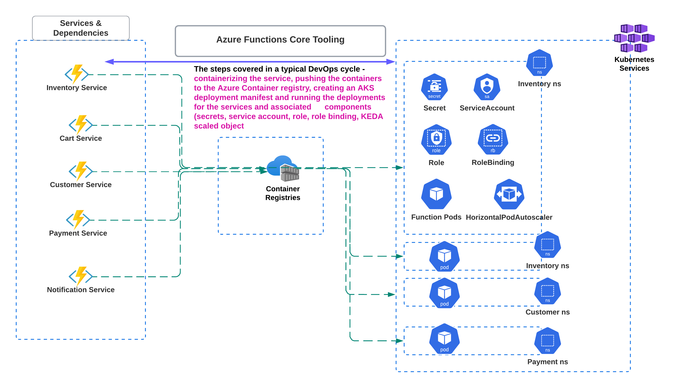
Deploying Function pods to AKS – Azure Function Core Tools

Slide 16
Azure Functions on Kubernetes with KEDA
Target state for cloud scale deployments and expansion
Move the new services as & when they are ready to be moved to the cloud
You still have options to run the services as is in Azure Functions, containerize and run in Functions or deploy to AKS to fit the ecosystem design (standardized deployment and management)

Slide 17
Demo: Packaging & Deploying Function apps to AKS

Slide 18
References
Containerizing the function apps and deploying to AKS Cluster
https://learn.microsoft.com/en-us/azure/azure-functions/functions-kubernetes-keda#deploying-a-function-app-to-kubernetes
https://learn.microsoft.com/en-us/azure/azure-functions/functions-core-tools-reference?tabs=v2#func-kubernetes-deploy
https://github.com/kedacore/sample-hello-world-azure-functions

Slide 19






Platinum Partner
Gold Partner
Silver Partner

Slide 21
An App Modernization Journey with Containers in the last mile
Sriram Ganesan
Architect- Cloud Transformation & Engineering at Virtusa

